Slide 1


Slide 2
ExpressJet – Performance Summary

Slide 3
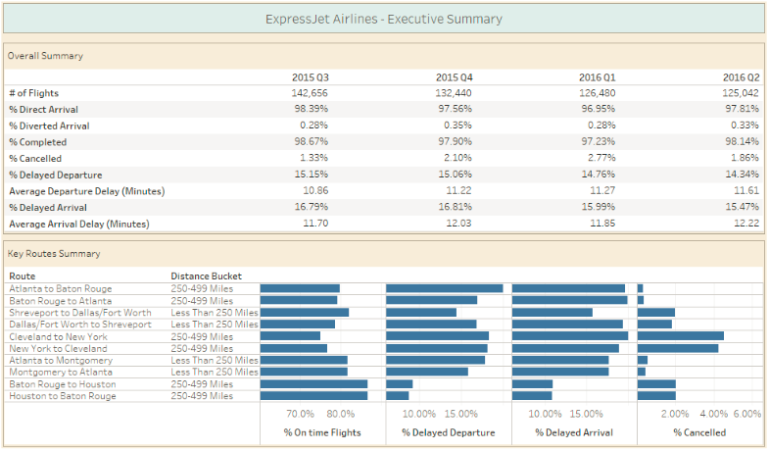
Performance of ExpressJet Airlines between July 2015 to June 2016

Slide 4
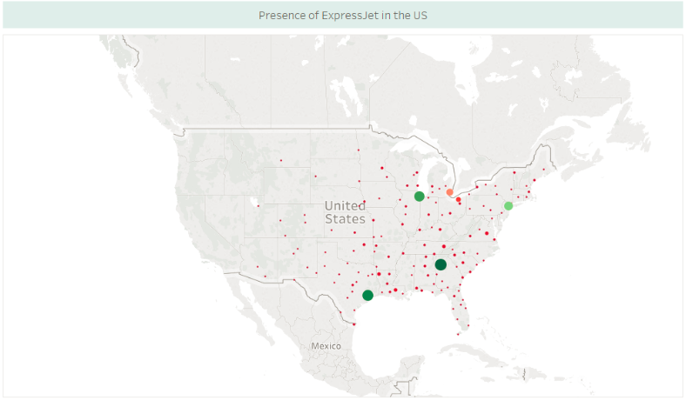
ExpressJet's market presence in the Central and Eastern part of US

Slide 5
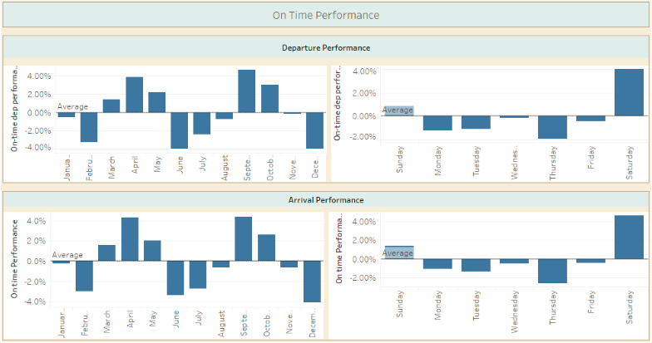
Poor performance in the month of Feb, June and Dec. Performance on weekends is better than weekdays

Slide 6
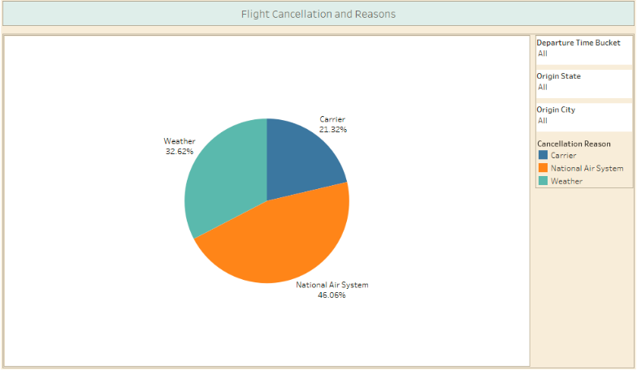
Majority of flights have been cancelled due to National Air System

Slide 7
Domestic Airline Industry - US

Slide 8
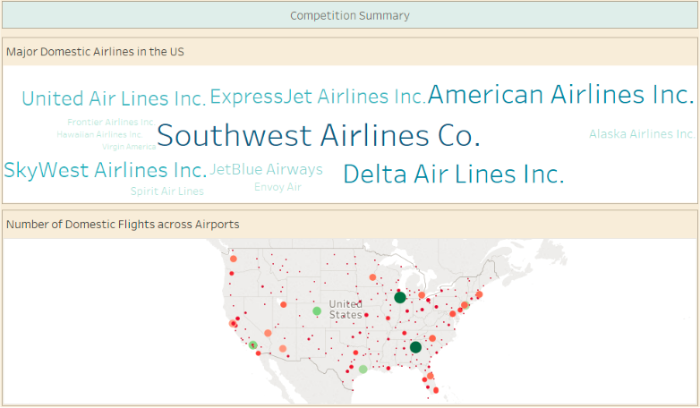
Summary of US Domestic Airlines – Southwest Airlines has the most number of flights

Slide 9
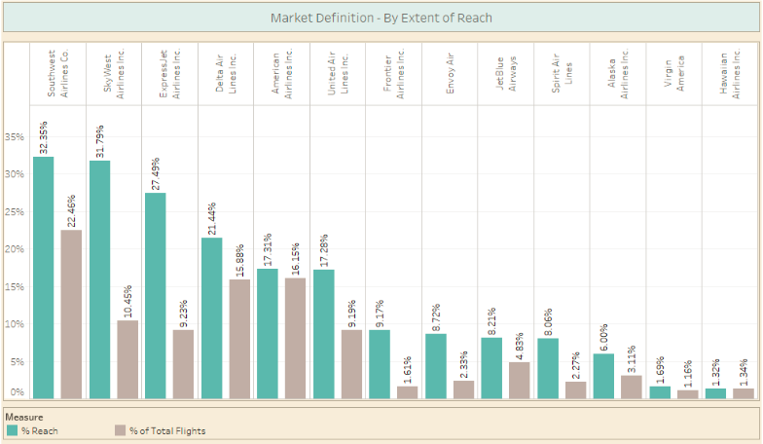
ExpressJet, SouthWest and SkyWest strive towards increased presence. Delta and American Airlines are Niche players

Slide 10
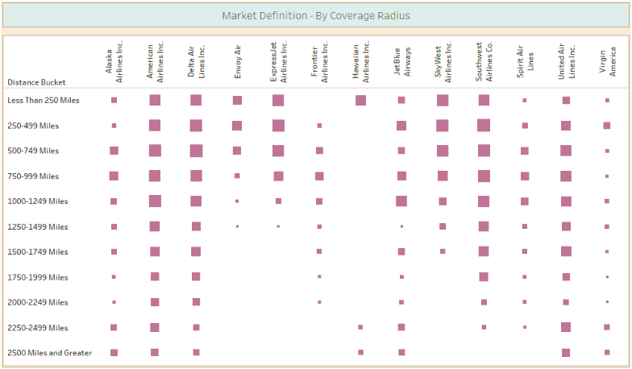
ExpressJet covers short to medium distance

Slide 11
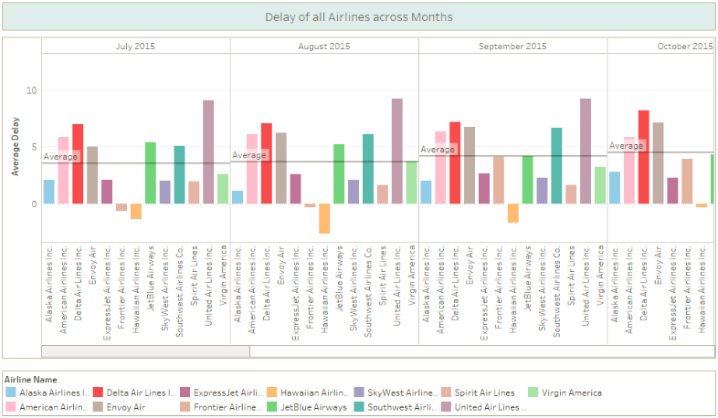
The average total delay is mostly below average throughout the analysed time for ExpressJet

Slide 12
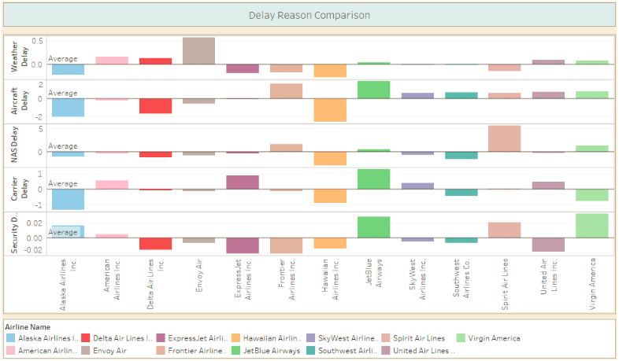
Most common delay reason across Airlines is Aircraft delay

Slide 13
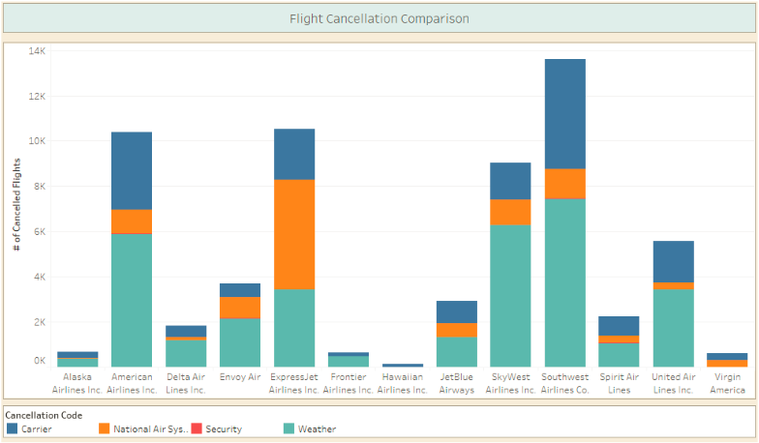
Southwest Airlines has the highest number of cancelled flights with maximum flights cancelled due to Weather

Slide 14
Competition Analyses

Slide 15
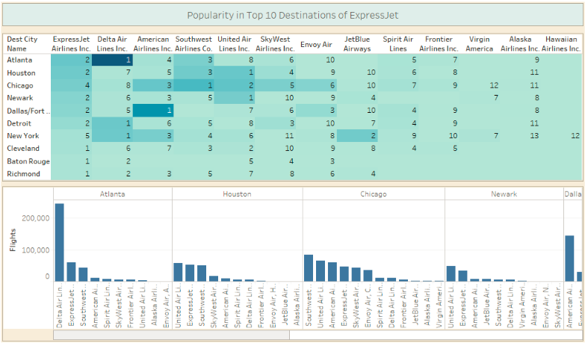
Atlanta and Dallas markets have been captured by other airline, in other cities ExpressJet and SouthWest are closely competing

Slide 16
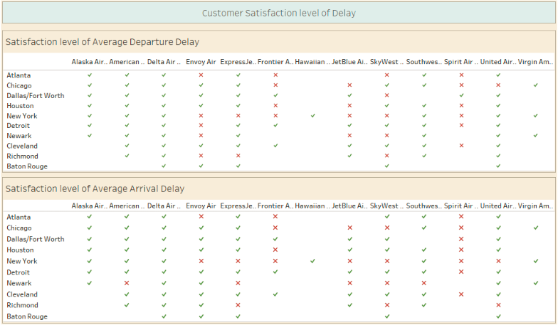
ExpressJet has unsatisfactory performance in New York, Newark and Richmond

Slide 17
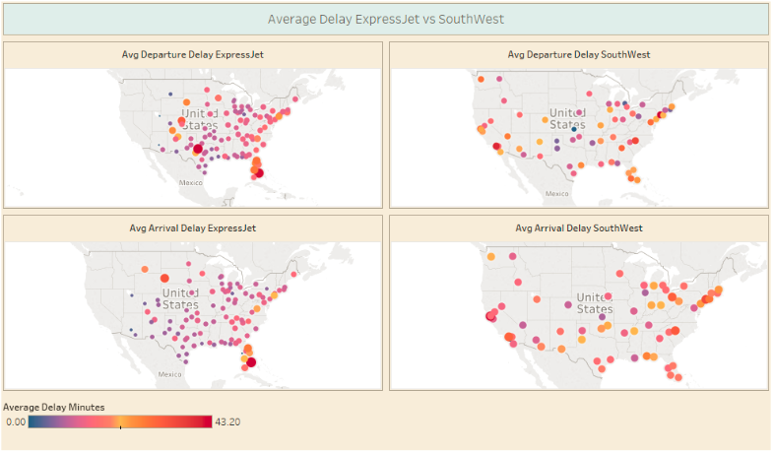
SouthWest has consistent average delay across cities, EJ average delay is below average for most of the cities

Slide 18
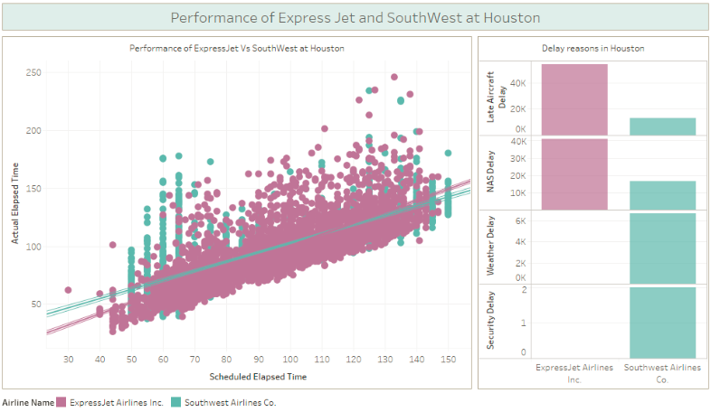
EJ does not maintain a fixed schedule across months, SW has organized schedule through the year

Slide 19
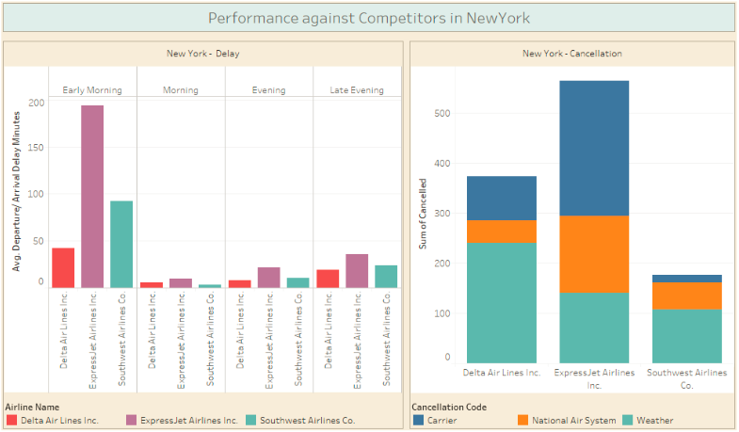
EJ has a scope for improvement for Average Delay as compared to SW

Slide 20
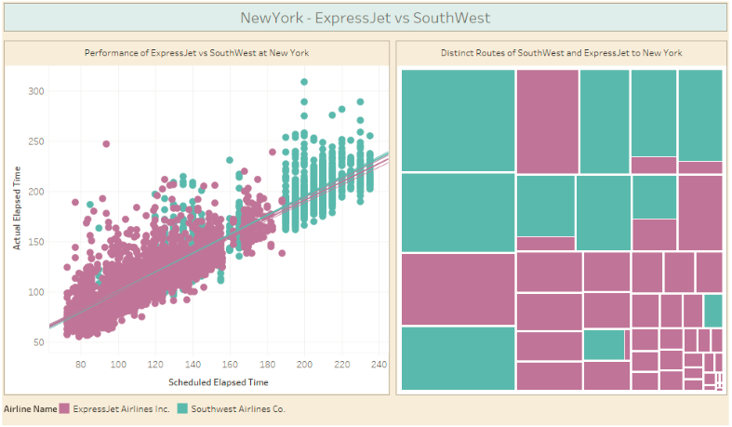
SW focuses on popular cities whereas EJ covers many small cities which are not that popular

Slide 21
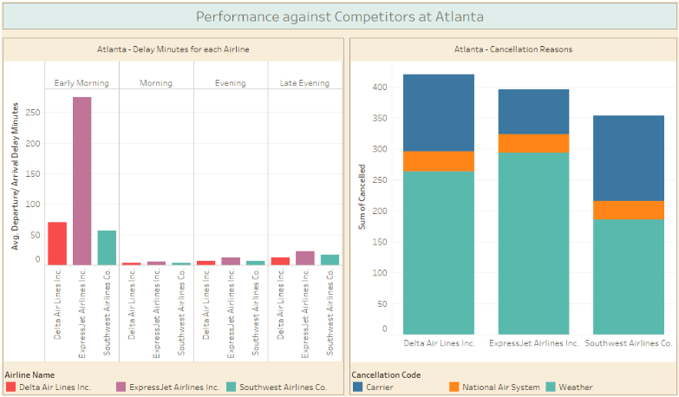
EJ has very high Average Delay in the Early morning time and maximum flights cancelled due to Weather

Slide 22
Potential Market

Slide 23
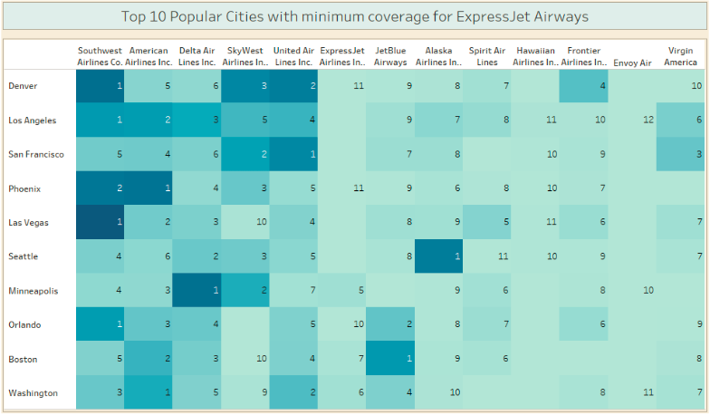
Scope for Business Expansion

Slide 24
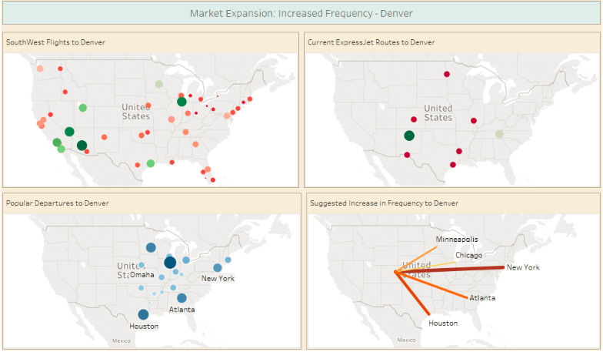
Denver - Major Airport in the US. Increase the frequency from these cities

Slide 25
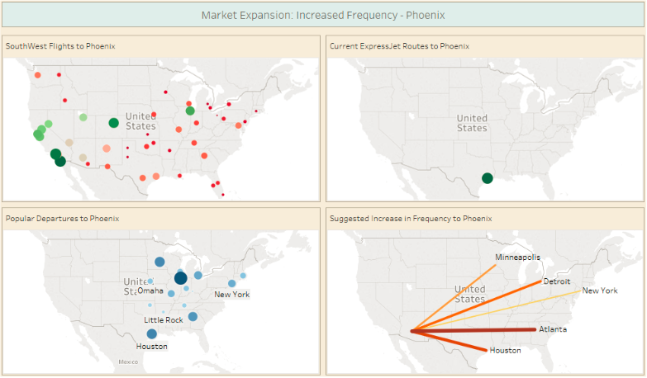
Phoenix - Major Airport in the US. Increase the frequency from these cities

Slide 26
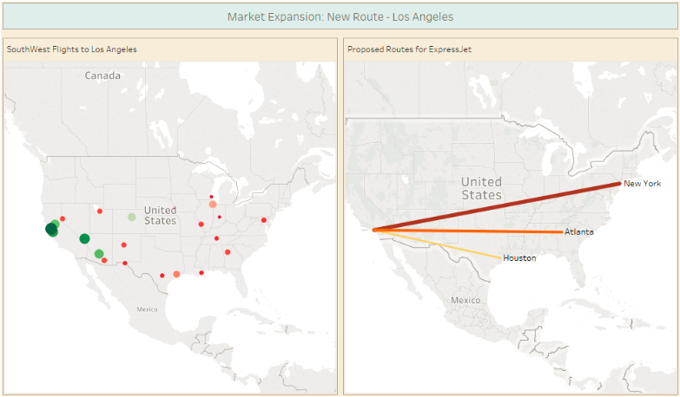
Proposed new route to Los Angeles - Market Expansion

Slide 27
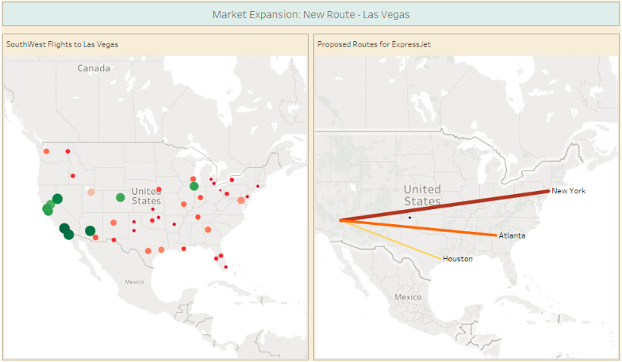
Proposed new route to Los Vegas - Market Expansion

